Slide 1

Genshin Impact
Jacqueline Nguyen Gordon Tong

Slide 2

Project Description
Build a team of 4 characters
Edit a team
Find out what materials are needed for each character
Built as a web app

Slide 3

Implementation Details
IDE: VSCode
Database:
MySQL
Language
HTML, CSS, Javascript

Slide 4
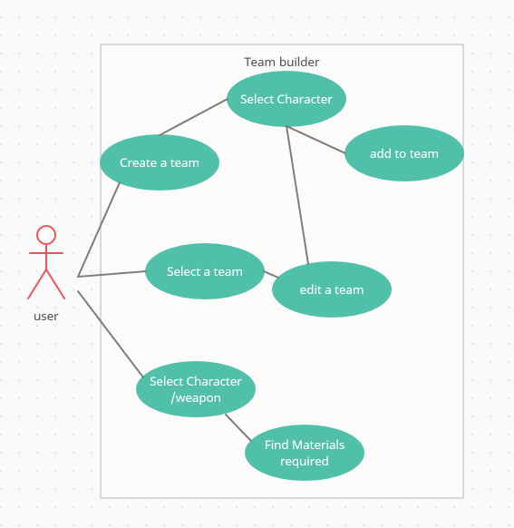
Use-Case Diagram
Create a team of 4 unique characters
Be able to edit the team
Find what materials required for character ascension
Find materials required for weapon ascension

Slide 5
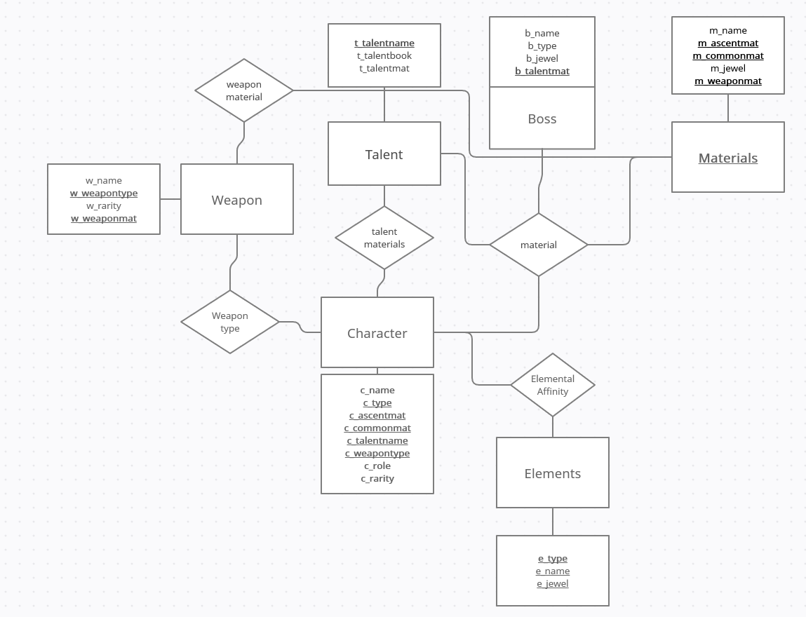
E/R Diagram and Schema

Slide 6

Thank you!

